Slide 1
The Medium Access Control Sublayer
Chapter 4

Slide 2
Channel Allocation Problem
Static channel allocation
Assumptions for dynamic

Slide 3
Assumptions for Dynamic Channel Allocation
Independent traffic
Single channel
Observable Collisions
Continuous or slotted time
Carrier sense or no carrier sense

Slide 4
Multiple Access Protocols
ALOHA
Carrier Sense Multiple Access
Collision-free protocols
Limited-contention protocols
Wireless LAN protocols

Slide 5
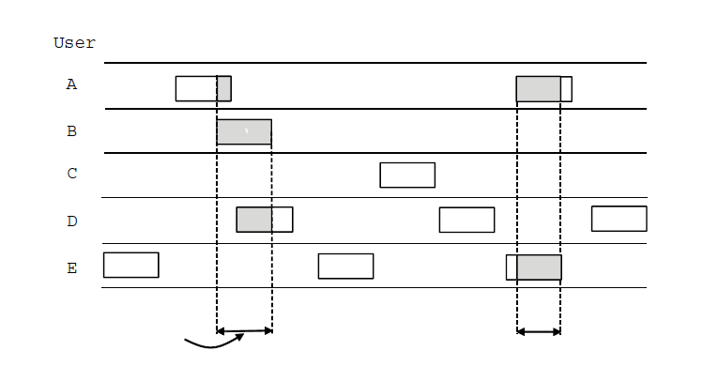
ALOHA (1)
User
A
B
C
D
E
Collision
Collision
Time
In pure ALOHA, frames are transmitted
at completely arbitrary times

Slide 6
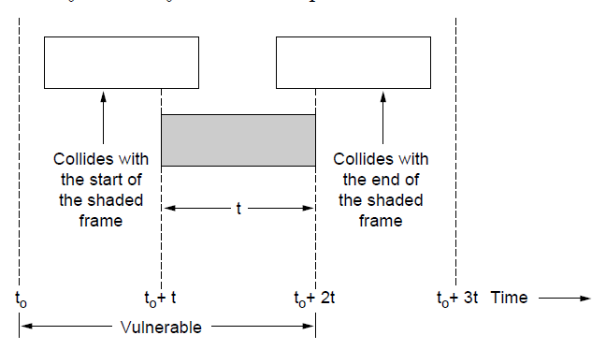
ALOHA (2)
Vulnerable period for the shaded frame.

Slide 7
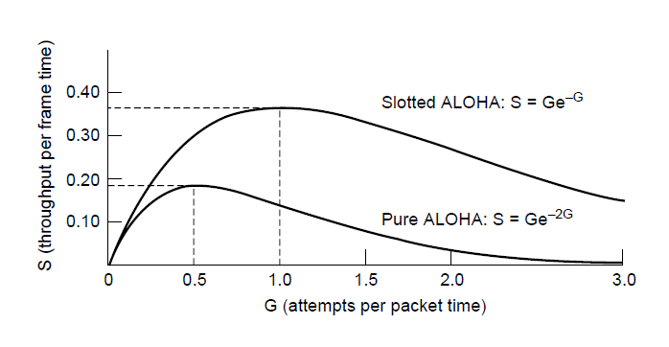
ALOHA (3)
Throughput versus offered traffic for ALOHA systems.

Slide 8
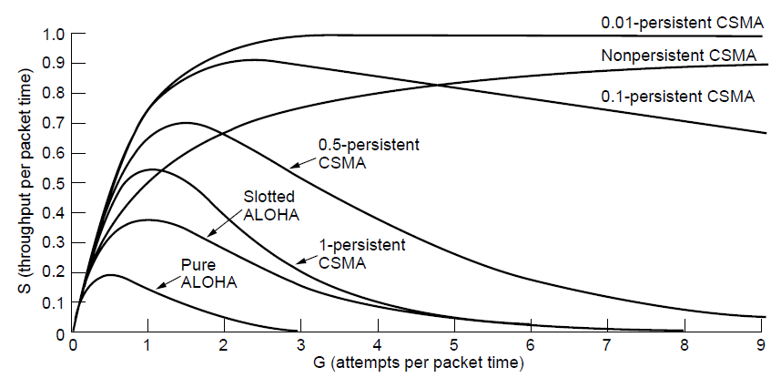
Persistent and Nonpersistent CSMA
Comparison of the channel utilization versus load for various random access protocols.

Slide 9
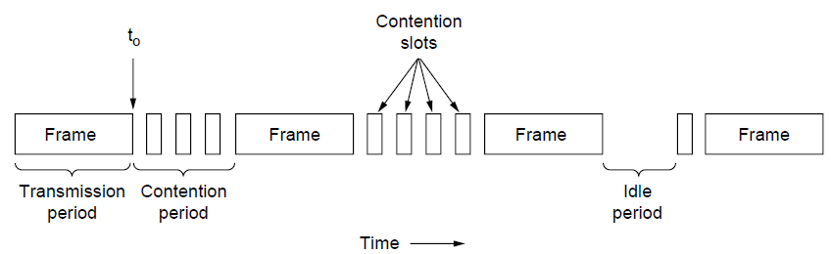
CSMA with Collision Detection
CSMA/CD can be in one of three states: contention, transmission, or idle.

Slide 10
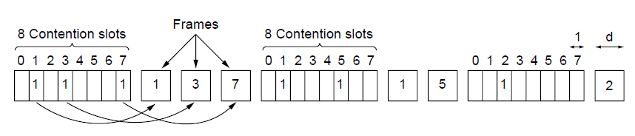
Collision-Free Protocols (1)
The basic bit-map protocol.

Slide 11
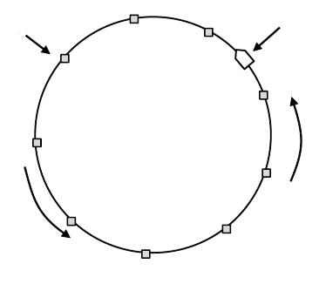
Collision-Free Protocols (2)
Token
Station
Direction of
transmission
Token ring.

Slide 12
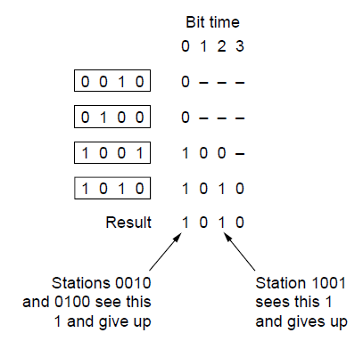
Binary Countdown
The binary countdown protocol. A dash indicates silence.

Slide 13
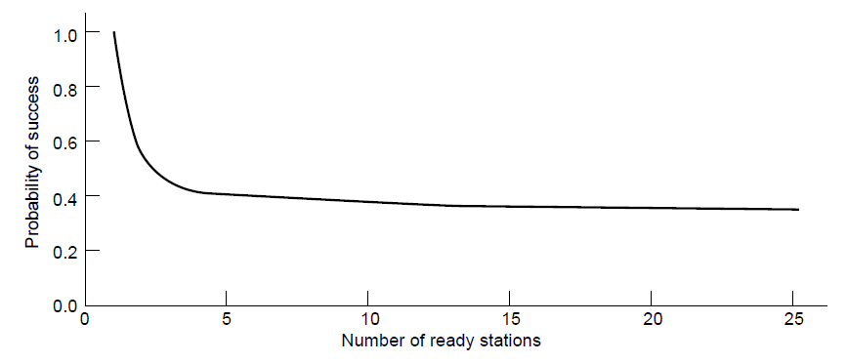
Limited-Contention Protocols
Acquisition probability for a symmetric contention channel.

Slide 14
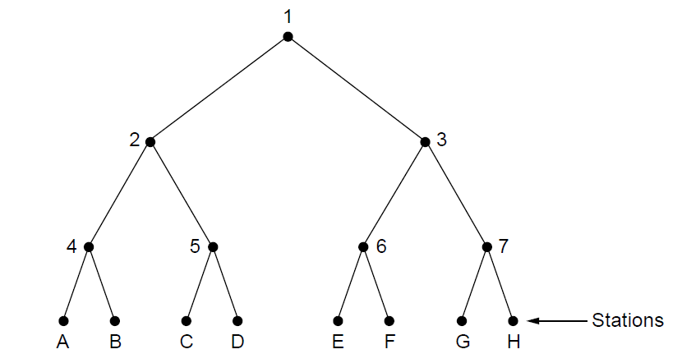
The Adaptive Tree Walk Protocol
The tree for eight stations

Slide 15
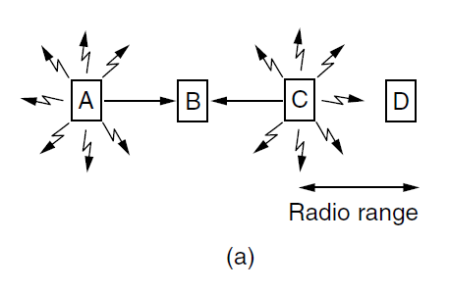
Wireless LAN Protocols (1)
A wireless LAN. (a) A and C are hidden terminals
when transmitting to B.

Slide 16
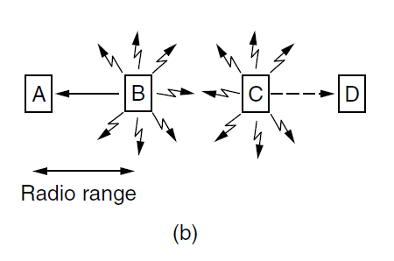
Wireless LAN Protocols (2)
A wireless LAN. (b) B and C are exposed terminals when transmitting to A and D.

Slide 17
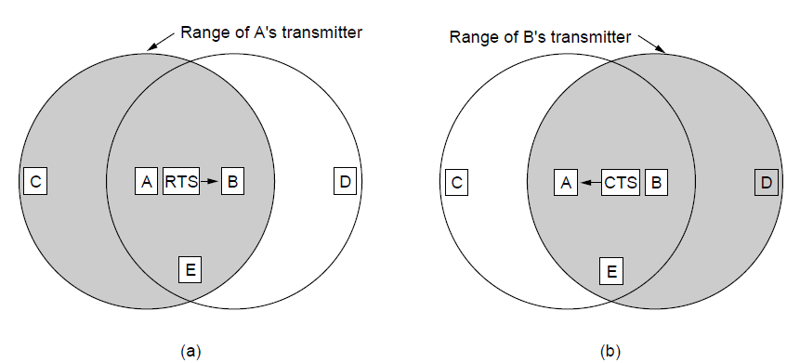
Wireless LAN Protocols (3)
The MACA protocol. (a) A sending an RTS to B. (b) B responding with a CTS to A.

Slide 18
Ethernet
Physical layer
MAC sublayer protocol
Ethernet performance
Switched Ethernet
Fast Ethernet
Gigabit Ethernet
10 Gigabit Ethernet
IEEE 802.2: Logical Link Control
Retrospective on Ethernet

Slide 19
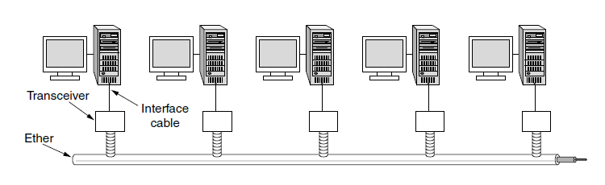
Classic Ethernet Physical Layer
Architecture of classic Ethernet

Slide 20
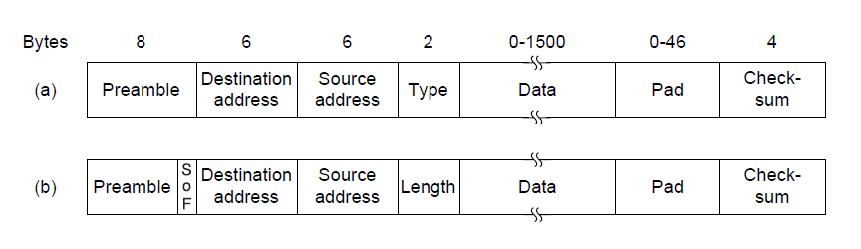
MAC Sublayer Protocol (1)
Frame formats. (a) Ethernet (DIX). (b) IEEE 802.3.

Slide 21
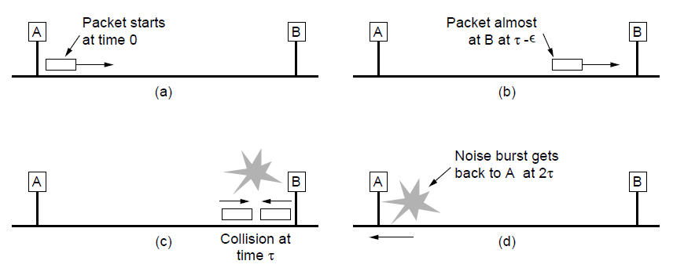
MAC Sublayer Protocol (2)
Collision detection can take as long as 2τ.

Slide 22
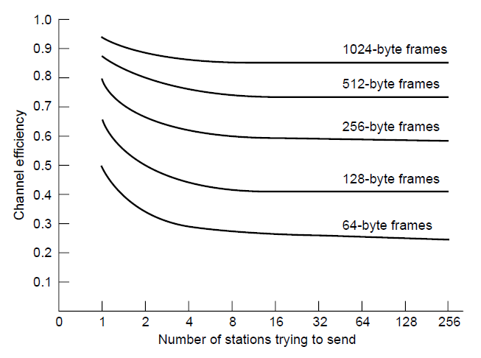
Ethernet Performance
Efficiency of Ethernet at 10 Mbps with 512-bit slot times.

Slide 23
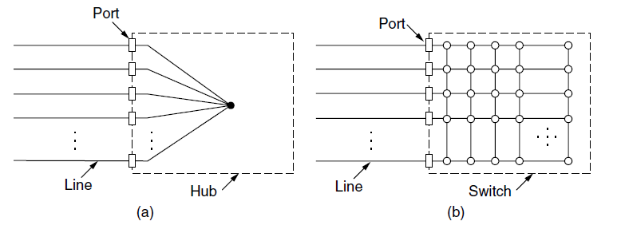
Switched Ethernet (1)
(a) Hub. (b) Switch.

Slide 24
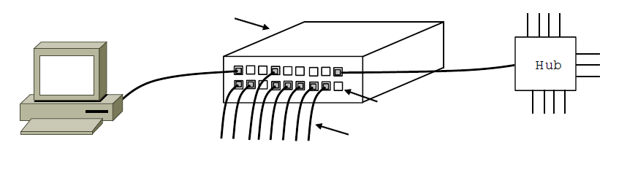
Switched Ethernet (2)
Switch
Hub
Switch ports
Twisted pair
An Ethernet switch.

Slide 25
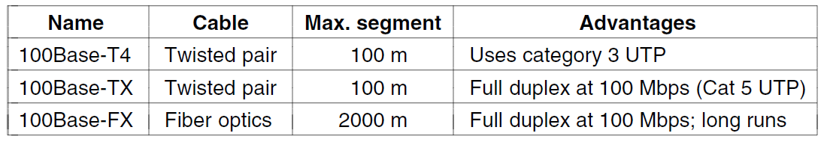
Fast Ethernet
The original fast Ethernet cabling.

Slide 26
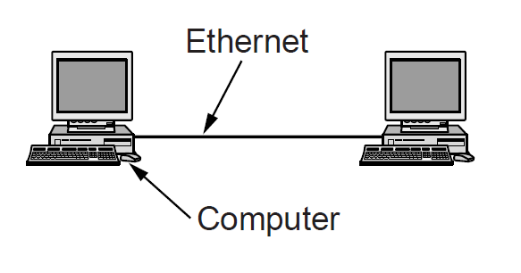
Gigabit Ethernet (1)
A two-station Ethernet

Slide 27
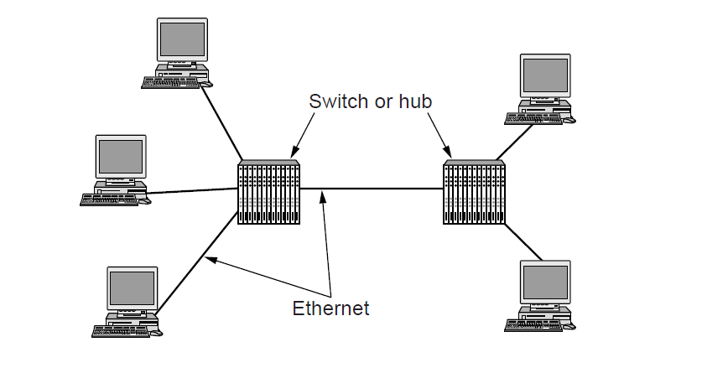
Gigabit Ethernet (2)
A two-station Ethernet

Slide 28
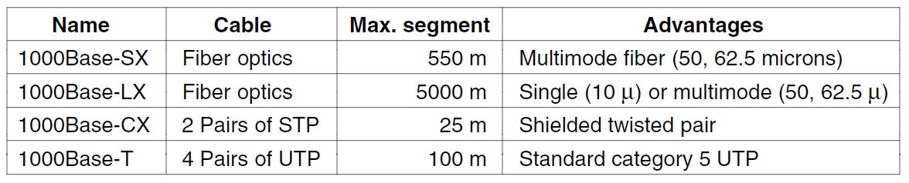
Gigabit Ethernet (3)
Gigabit Ethernet cabling.

Slide 29
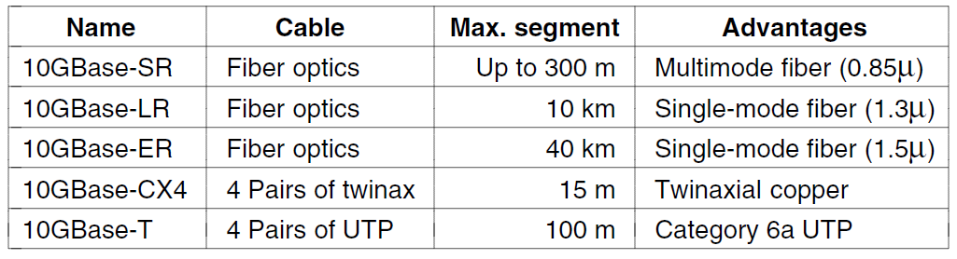
10 Gigabit Ethernet
Gigabit Ethernet cabling

Slide 30
Wireless Lans
802.11 architecture and protocol stack
802.11 physical layer
802.11 MAC sublayer protocol
802.11 frame structure
Services

Slide 31
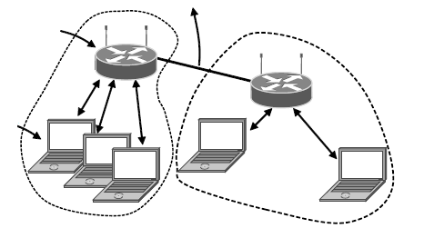
802.11 Architecture and Protocol Stack (1)
To Network
Access
Point
Client
802.11 architecture – infrastructure mode

Slide 32
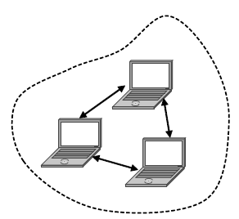
802.11 Architecture and Protocol Stack (2)
802.11 architecture – ad-hoc mode

Slide 33
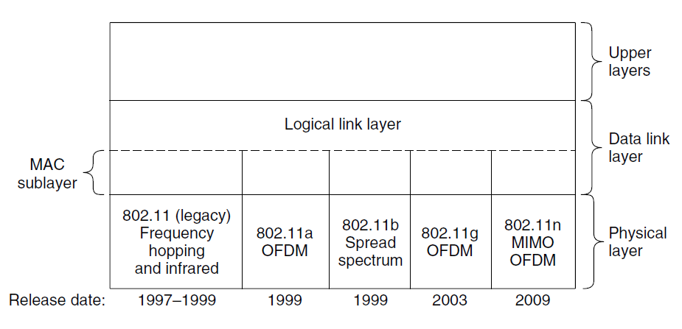
802.11 Architecture and Protocol Stack (3)
Part of the 802.11 protocol stack.

Slide 34
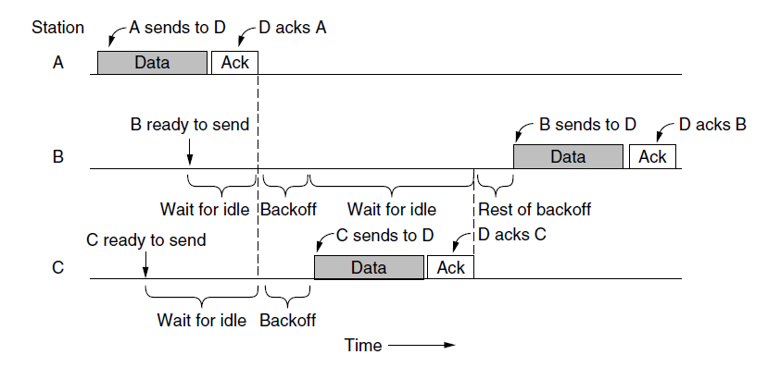
The 802.11 MAC Sublayer Protocol (1)
Sending a frame with CSMA/CA.

Slide 35
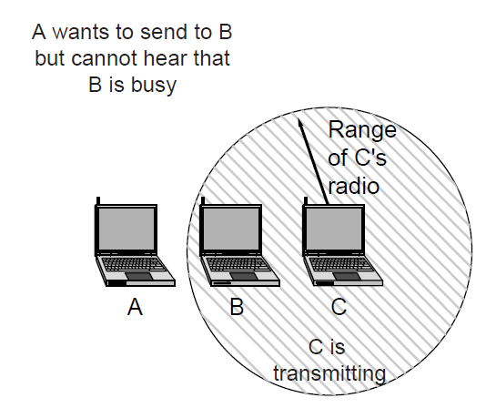
The 802.11 MAC Sublayer Protocol (2)
The hidden terminal problem.

Slide 36
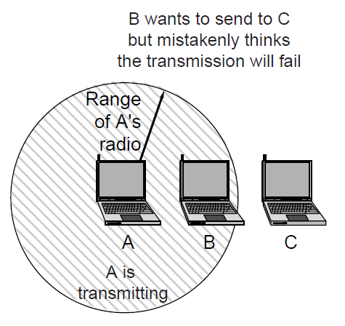
The 802.11 MAC Sublayer Protocol (3)
The exposed terminal problem.

Slide 37
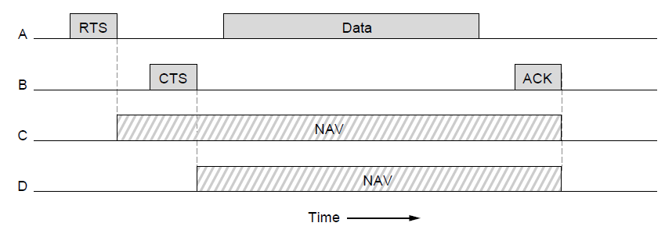
The 802.11 MAC Sublayer Protocol (4)
The use of virtual channel sensing using CSMA/CA.

Slide 38
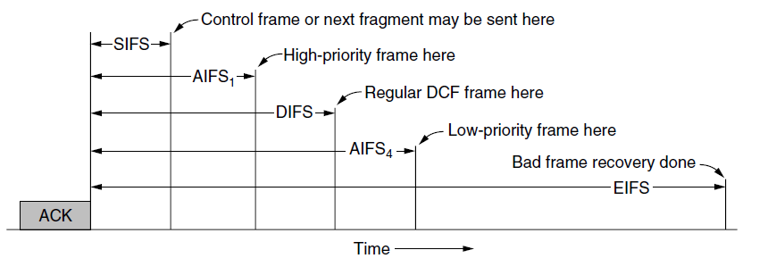
The 802.11 MAC Sublayer Protocol (5)
Interframe spacing in 802.11

Slide 39
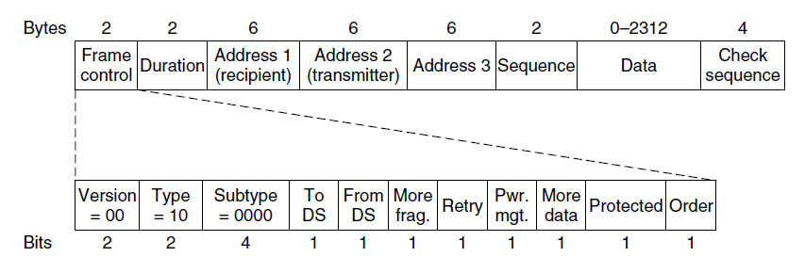
802.11 Frame Structure
Format of the 802.11 data frame

Slide 40
Broadband Wireless
Comparison of 802.16 with 802.11, 3G
802.16 architecture and protocol stack
802.16 physical layer
802.16 frame structure

Slide 41
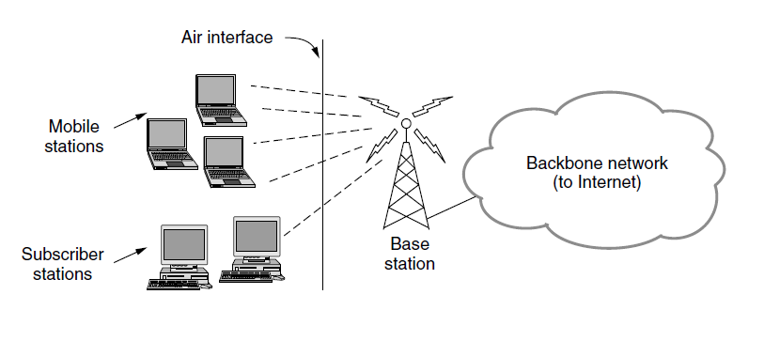
Comparison of 802.16 with 802.11 and 3G
The 802.16 architecture

Slide 42
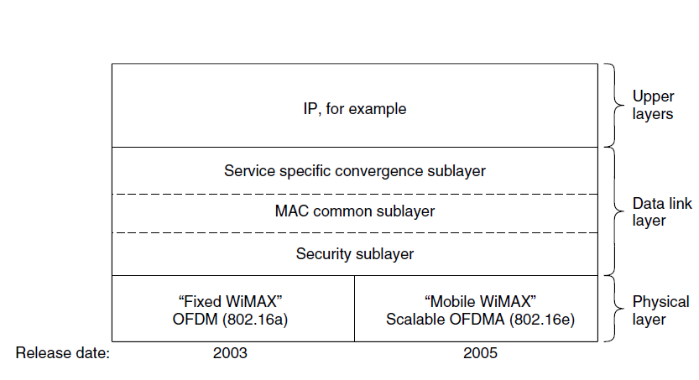
802.16 Architecture and Protocol Stack
The 802.16 protocol stack

Slide 43
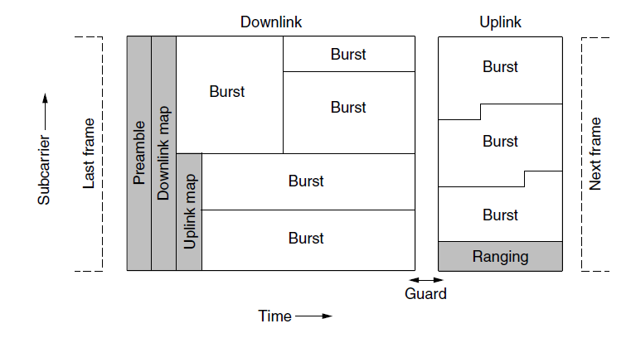
802.16 Physical Layer
Frames structure for OFDMA with time division duplexing.

Slide 44
802.16 MAC Sublayer Protocol
Classes of service
Constant bit rate service.
Real-time variable bit rate service.
Non-real-time variable bit rate service.
Best-effort service.

Slide 45
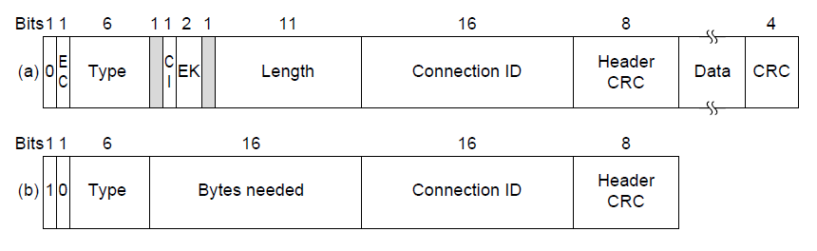
802.16 Frame Structure
(a) A generic frame. (b) A bandwidth request frame.

Slide 46
Bluetooth
Architecture
Applications
Protocol stack
Radio layer
Link layers
Frame structure

Slide 47
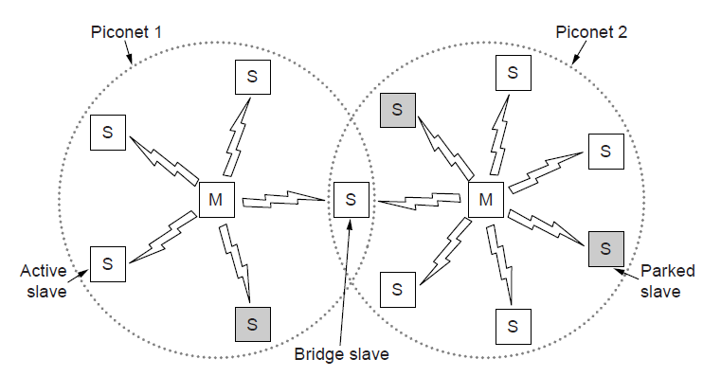
Bluetooth Architecture
Two piconets can be connected to form a scatternet

Slide 48
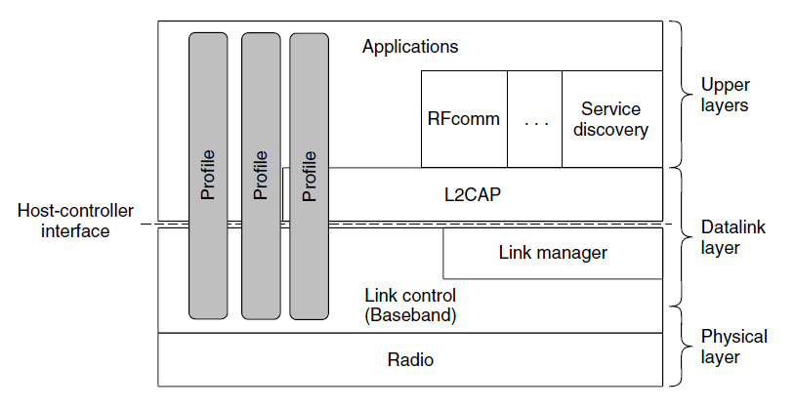
Bluetooth Protocol Stack
The Bluetooth protocol architecture.

Slide 49
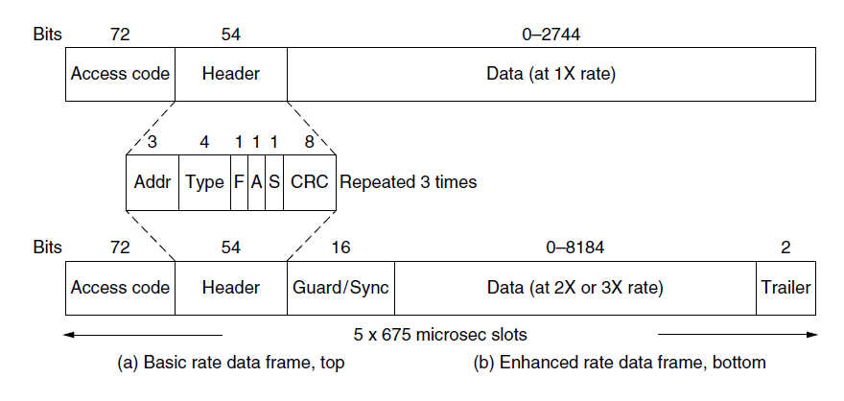
Bluetooth Frame Structure
Typical Bluetooth data frame at (a) basic, and
(b) enhanced, data rates.

Slide 50
RFID
EPC Gen 2 architecture
EPC Gen 2 physical layer
EPC Gen 2 tag identification layer
Tag identification message formats

Slide 51
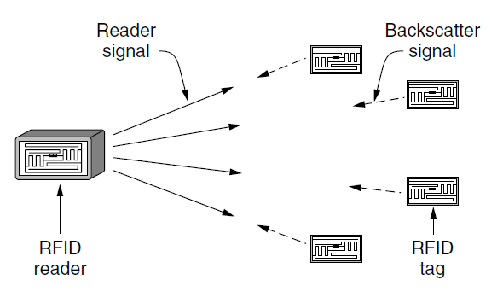
EPC Gen 2 Architecture
RFID architecture.

Slide 52
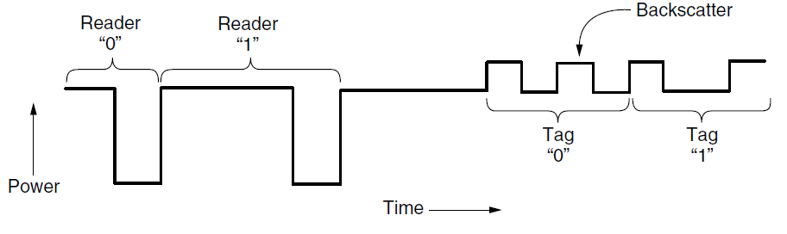
EPC Gen 2 Physical Layer
Reader and tag backscatter signals.

Slide 53
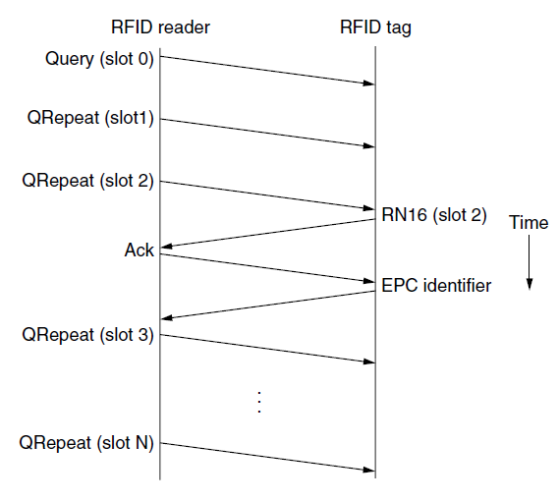
EPC Gen 2 Tag Identification Layer
Example message exchange to identify a tag.

Slide 54
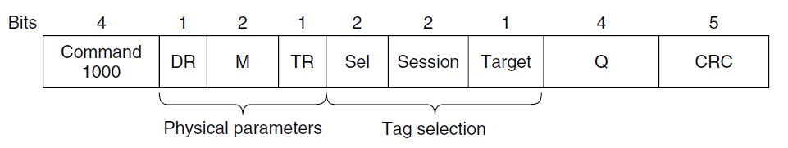
Tag Identification Message Formats
Format of the Query message.

Slide 55
Data Link Layer Switching
Uses of bridges
Learning bridges
Spanning tree bridges
Repeaters, hubs, bridges, switches, routers, and gateways
Virtual LANs

Slide 56
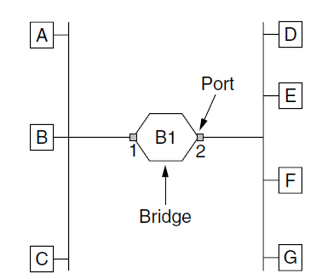
Learning Bridges (1)
Bridge connecting two multidrop LANs

Slide 57
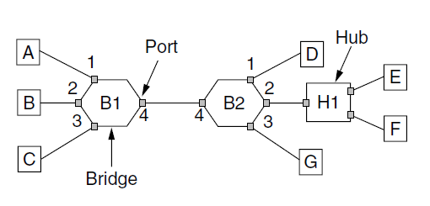
Learning Bridges (2)
Bridges (and a hub) connecting seven point-to-point stations.

Slide 58
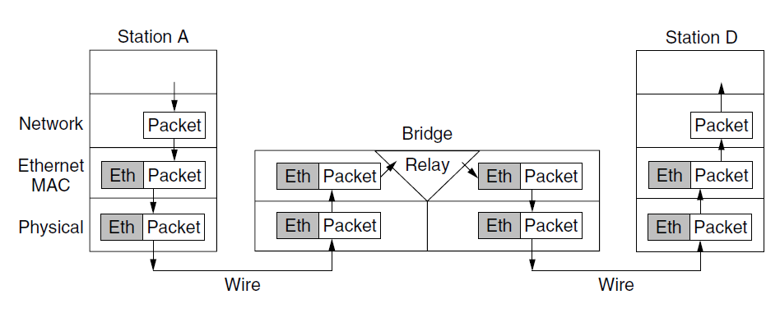
Learning Bridges (3)
Protocol processing at a bridge.

Slide 59
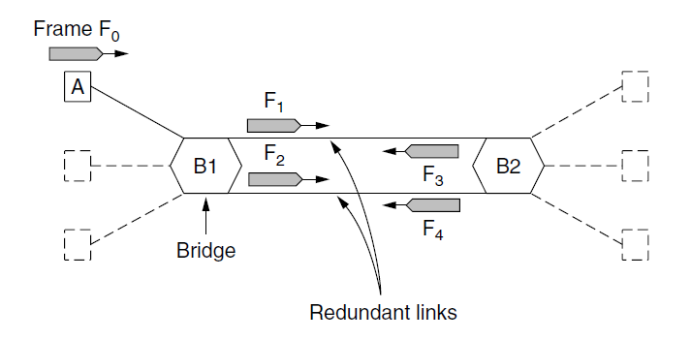
Spanning Tree Bridges (1)
Bridges with two parallel links

Slide 60
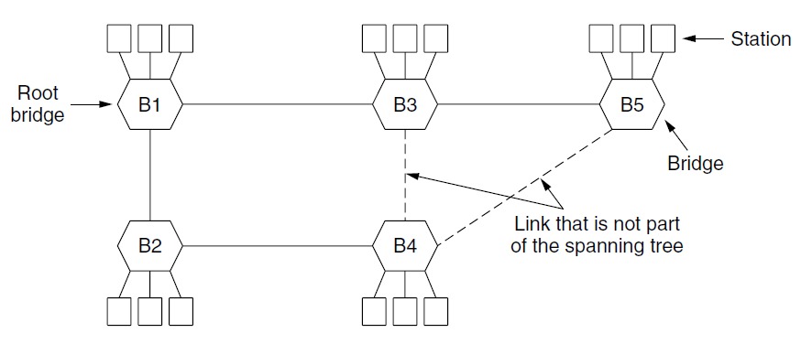
Spanning Tree Bridges (2)
A spanning tree connecting five bridges. The dotted lines are links that are not part of the spanning tree.

Slide 61
Poem by Radia Perlman (1985)
Algorithm for Spanning Tree (1)
I think that I shall never see
A graph more lovely than a tree.
A tree whose crucial property
Is loop-free connectivity.
A tree which must be sure to span.
So packets can reach every LAN.
. . .

Slide 62
Poem by Radia Perlman (1985)
Algorithm for Spanning Tree (2)
. . .
First the Root must be selected
By ID it is elected.
Least cost paths from Root are traced
In the tree these paths are placed.
A mesh is made by folks like me
Then bridges find a spanning tree.

Slide 63
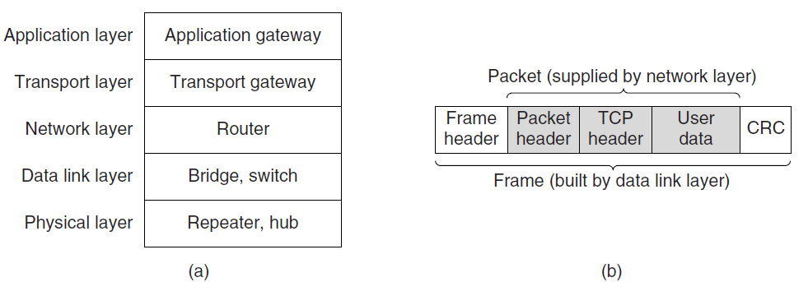
Repeaters, Hubs, Bridges, Switches, Routers, and Gateways
(a) Which device is in which layer.
(b) Frames, packets, and headers.

Slide 64

Virtual LANs (1)
A building with centralized wiring using hubs and a switch.

Slide 65

Virtual LANs (2)
Two VLANs, gray and white, on a bridged LAN.

Slide 66

The IEEE 802.1Q Standard (1)
Bridged LAN that is only partly VLAN-aware. The shaded symbols are VLAN aware. The empty ones are not.

Slide 67

The IEEE 802.1Q Standard (2)
The 802.3 (legacy) and 802.1Q Ethernet frame formats.

Slide 68
End
Chapter 4

